Slide 1

Internet of things System
Lucky Guys (LG)
Team 3 14/May/2015

Slide 2
Contents
Project Scope
1.1. Context
1.2. Stakeholders
1.3. System Context Diagram
Architectural Drivers
2.1. Function Requirements
2.2. Use Case Analysis
2.3. Constraints
2.4. Quality Attributes
Project Strategy
3.1. Development Process
3.2. Schedule
3.3. Project Risk
3.4. Role & Responsibility
3.5. Time Logging & Project Tracking

Slide 3
1. Project Scope
Project Scope
1.1. Context
1.2. Stakeholders
1.3. System Context Diagram
Architectural Drivers
Project Strategy

Slide 4
1.1 Context (1/2) – Market, Organizational
Market Context | stackholders | Ecosystem of developers, VARs, 3rd party H/W and S/W developers, 3rd party service providers, installers, maintainers, customer, S/A producer, home builder, smart appliance producer, utilities companies
 | Product Velocity | 10 years
 | Price | Infrastructure : $ 200k per management system Monthly cost : $ 12
 | Functional expectations | IoT 서비스를 제공(집, 회사등)
Organizational Context | Project Roles and responsibilities | Project Manager Architect Test Manager Package Manager Protocol Manager Documentation Manager Developer (all team members) (architecturally neutral project team organization)
 | Technological background | LG 전자 제품 및 시스템 개발 (Network Protocol, BSP, Embedded, Mobile, Display) Development experience in same domain – Electronic products/systems
 | Communication channel | Mobile Msg., Using E-mail, Off-line meeting
 | Organizational culture | 긍정적인 생각 새로운 것에 대한 도전 고객 중심의 사고 상호에 대한 배려 Open-minded Be eager to success Make better product for customer
Notes:
첫번째 분석으로 Context를 4가지 관점에서 분석 하였다.
Market, Organizational Context는 다음과 같다.
Market을 분석을 통하여 stakeholder를 분석하였다.

Slide 5
1.1 Context (2/2) – Business, Technological
Business Context | Competitive position | 4 competitor
 | Market Strategy | U+ mobile network service 제휴
 | Profit model | 인프라를 통신사(U+ mobile) or 3rt party에 판매 및 SA & application 인증에 따른 수익 창출 Mining Data를 이용한 수익 창출
 | Future direction | M2P & M2M로 서비스 확장
Technological Context | Development Skills | Java, C / C++, MFC
 | Tools | Eclipse, Arduino IDE
 | SW platform | Windows, android, Arduino
 | HW platform | Arduino, Labtop computer, Cell phone
Notes:
Date of Delivery,

Slide 6
2. Architectural Drivers
Project Scope
Architectural Drivers
2.1. Function Requirements
2.2. Use Case Analysis
2.3. Constraints
2.4. Quality Attributes
Project Strategy

Slide 7
2.1 Functional Requirement
Req. ID | Description
FT_REQ_001 | System must take orders from customers, fill the orders, and move them to the shipping center for packing and shipping
FT_REQ_002 | Customers need to specify the widgets they want to buy and number of each that they want to buy
FT_REQ_003 | Orders will be sent to the warehouse where they will be scheduled for service in the order of arrival
FT_REQ_004 | The warehouse consists of a robot that is capable of visiting various inventory stations in the warehouse where order items will be loaded
FT_REQ_005 | An inventory station holds inventory of one or more different types
… | …
FT_REQ_026 | The status of the load switches and the photo sensors can be read with the Arduino.
Notes:
1번 REQ 만 설명

Slide 8
2.2 Use Case Description
Summary of whole use case description
ID | User Goal | Description
UC01 | Request SA info. | 사용자가 SA node 정보를 요청한다
UC02 | Actuator control | 사용자는 Actuator를 제어한다.
UC03 | Sensor monitoring | 사용자는 Sensor 값을 확인하다
UC04 | System Configration | 사용자가 시스템 환경설정을 한다
UC05 | Request Log | 사용자가 기록(logging)된 정보를 요청한다
UC06 | User LogIn | 사용자가 시스템에 로그인 한다
UC07 | Resister SA node | 사용자는 새로운 SA node를 등록 한다
UC08 | Remove SA node | 사용자는 기존의 등록된 SA node를 제거한다

Slide 9
2.2 Use Case Scenario : Request SA info.
Use Case Title : Request SA info. | Use Case ID : UC01
General use case description: This use case describe how to request SA node information by user
Entities involved: User, Internet of things system(IoT System)
Preconditions User is connected to IoT System(Log in)
Primary use case flow of events: User select SA info. menu. System query SA node info. to DB. System display SA nodes information(number, type) System update log to DB.
Primary use case post-conditions: User can see SA nodes information(number, Type), System update log to DB.

Slide 10
2.2 Use Case Scenario : Actuator control
Use Case Title : Actuator Control | Use Case ID : UC02
General use case description: This use case describe how to control Actuator node by user
Entities involved: User, Internet of things system(IoT System), SA node
Preconditions User is connected to IoT System(Log in), Already SA nodes installed, UC01
Primary use case flow of events: User select Actuator control menu. System display the Actuator List. User select Actuator(Lamp, Alarm, Door) System request the Actuator state to Actuator. System display the Actuator current state. User control the Actuator action.(Lamp on/off, Alarm Set/Off, Door Open/Close) System send command to the Actuator. System update log to DB. - 2~8 repeat. 9. User select exit menu. 10. System menu is exit.
Primary use case post-conditions: System update Actuator state & log to DB

Slide 11
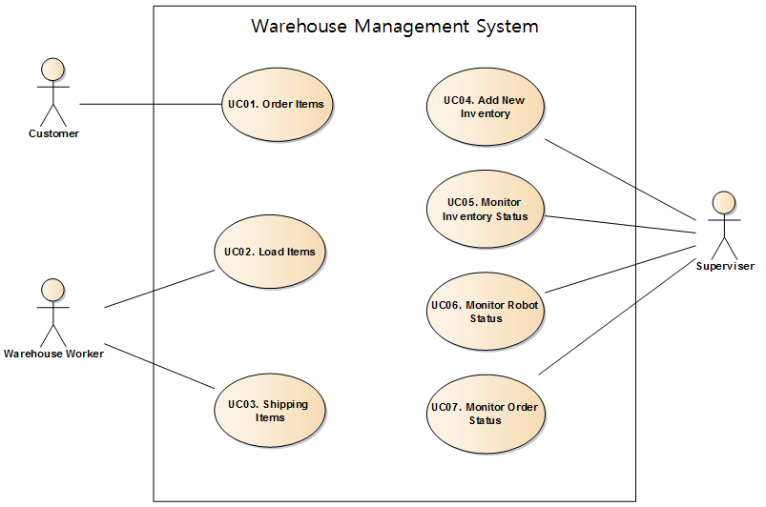
2.2 Use Case Analysis
Analysis requirement using use case
User level goal of the Warehouse Management System (WMS)
Notes:
FR을 기반으로 Use Case를 분석 하였고, User Level의 Goal을 추출 하였다.

Slide 12
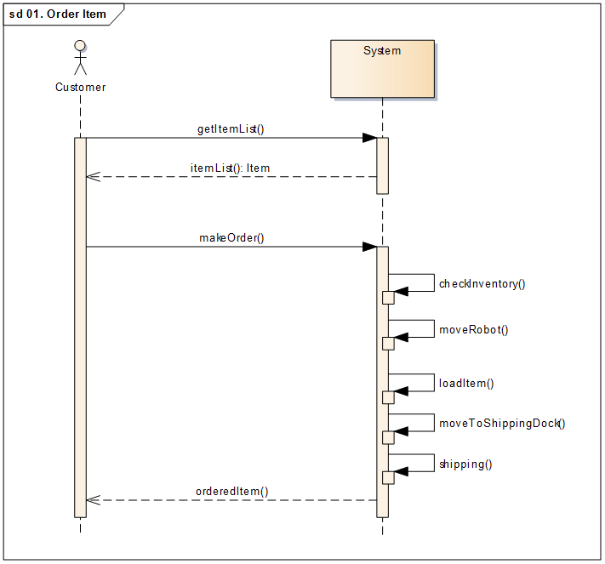
2.2 UC-02 System Sequence Diagram (SSD)
SSD for capture system’s behavior
Notes:
시스템의 Operation을 추출하기 위하여 UCD로 부터 SSD를 그려 보았다.

Slide 13
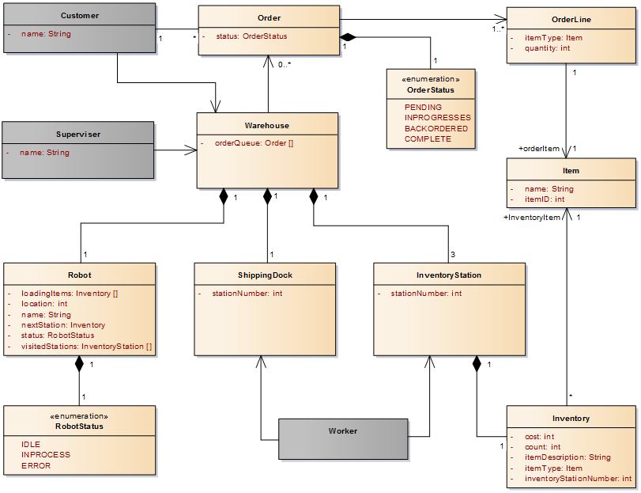
2.2 Domain Model
Initial draft of the problem domain
Notes:
Real world에 대한 추상화 이고, 도메인 모델은 시스템 설계시 오프젝트의 후보군이 될 수 있는 단어를 제공해준다.
도메인 모델을 통하여 FR 문서를 하나의 그림으로 정리할 수 있다.

Slide 14
2.3 Business Constraints
ID | Description
B_CON_001 | Schedule : 25th June
B_CON_002 | Human Resources: 6 persons
B_CON_003 | Per person a day is 4 hours
B_CON_004 | Need co-work a constructor if we enter the new market
Notes:
Business Context로 부터 우리가 변경할 수 없는 부분을 Business Constraints로 분석 하였다.

Slide 15
2.3 Technical Constraints
ID | Description
T_CON_001 | Customers use their laptop to place orders
T_CON_002 | To discern the navigation lines, infrared (IR) sensors are on the bottom of the robot
T_CON_003 | Robot has servos for moving
T_CON_004 | Robot has the Wi-Fi card to communicate with other applications
T_CON_005 | Robot is controlled by Arduino Uno
T_CON_006 | Programming Language for Arduino is sketch
T_CON_007 | Arduino Uno Clock Speed: 16Mhz
T_CON_008 | Arduino Uno RAM: 2KB, EEPROM: 1KB
T_CON_009 | Arduino Uno Flash: 32KB
T_CON_010 | Arduino IDE version is 1.0.4
Notes:
아두이노를 꼭 사용해야 하므로 아두이노의 제약사항이 기술적인 제약사항으로 보인다.

Slide 16
2.4 Quality Attributes
ID | QA Category | Description
QA-01 | Modifiability | Warehouse management system can be enlarged in physically
QA-02 | Modifiability | Fulfilling an order which Robot cannot handle immediately
QA-03 | Availability | If robot's IR sensor was broken, error status can be monitored in management system
QA-04 | Availability | Loss of WIFI Communication between robot and warehouse
QA-05 | Performance | The system should able to complete an order within required time from customer order
Collect quality attribute scenario for decide architectural design
Notes:
브레인 스토밍에 의하여 이렇게 추출하였으며, 세부 사항은 고객에게 질문을 하여 확정을 하였다.
QA는 프로젝트가 진행되면서 계속 refine 할 것이다.

Slide 17
2.4 Example of Quality Attribute Scenario
QA-04 : Loss of WiFi Communication between robot and warehouse
Scenario Title: Availability | Scenario ID: QA-04
Raw Quality Attribute Description: | Robot or Warehouse availability
Source of Stimulus: | Robot or Warehouse WiFi module (HW or SW)
Stimulus: | Loss of WiFi communication between Robot and Warehouse causes Robot or Warehouse not to work
Environmental Condition | During WiFi communication between Robot and Warehouse
System Element: | •Robot WiFi Communication Module (HW or SW) •WMS WiFi Communication Module (HW or SW)
System Response: | WMS detect and notify Loss of WiFi communication error status to supervisor, and repair error condition
Significant Measures: | •Detect and notify WiFi communication failure in 30 seconds by WMS •Repair within 1 minute

Slide 18
3. Project Strategy
Project Scope
Architectural Drivers
Project Strategy
3.1. Development Process
3.2. Schedule
3.3. Project Risk
3.4. Role & Responsibility
3.5. Time Logging & Project Tracking

Slide 19
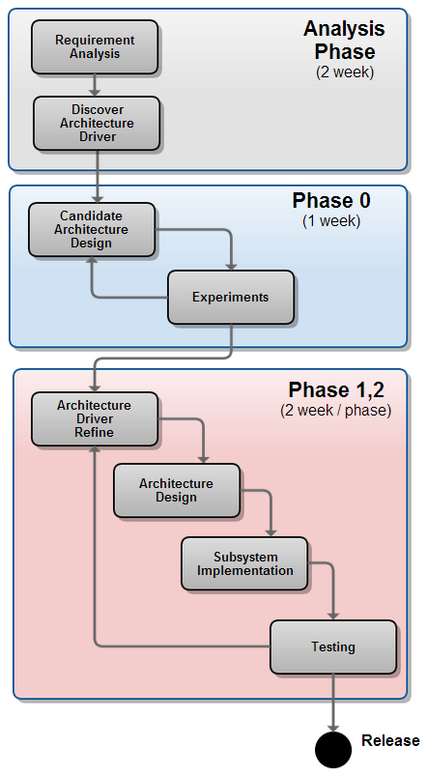
3.1. Development Process
Iterative Process
Analysis Phase (2 Week)
Analysis problem domain
Analysis functional requirement
Collect quality attributes
3 Phase of development process
Phase 0 (1 Week)
Experiments phase
Just move robot and network access
Phase 1 (2 Week)
Architecturally significant feature first
Interface of each sub-systems
Interactions within sub-systems
Phase 2 (2 Week)
Refine QA & FR
Refine architecture
Implementation
now
Notes:
반복하게 진행한다.
분석 기간이 너무 짧아 전체 분석이 어렵기 때문에 반복 점진적인 프로세스를 선택하였다.

Slide 20
3.2 Overall Project Schedule
Activity | -2W | -1W | 1W | 2W | 3W | 4W | 5W | Output
 | Plan & Analysis Phase |  | Phase 0 | Phase 1 |  | Phase 2
Planning |  |  |  |  |  |  |  | Project Planning Document
Requirement Analysis |  |  |  |  |  |  |  | Architecture Driver Document
Design |  |  |  |  |  |  |  | Architecture Specification Document
Implementation |  |  |  |  |  |  |  | Product
Testing |  |  |  |  |  |  |  | Testing Document
5/12
Initial Plan
WBS
WBS refined
5/12
Quality Attribute scenarios
QA²⁾ Refine #1
FR¹⁾ Analysis
Requirement Refine
QA Refine #2
Experiments
Sub System Design
Sub System Refined
Notional Architecture
Architectural Design
Architecture Refined
Reflect refined architecture
Phase #1 Done
Release
System Test
Test Plan
Integration Test
Release
* FR : Functional Requirement
** QA : Quality Attribute
Done
To Be Done

Slide 21
3.3 Project Risk
Risk | Impact | Probability | Risk Exposure | Risk Priority
No prior experience on Arduino development | Marginal | Probable | 6 | 4
No understanding on Motor Control Algorithm | Marginal | Probable | 6 | 4
No development process experience based on Architecture Centric Design Method(ACDM) | Critical | Probable | 9 | 2
Short development time | Marginal | Imminent | 8 | 3
Limited time for using warehouse table | Critical | Imminent | 12 | 1
Too low computation power of Arduino | Marginal | Probable | 6 | 4
Impact:
Catastrophic(4): would not repeat experience
Critical(3): repeated, but painful
Marginal(2): uncomfortable
Negligible(1): not painful
Probability:
Imminent(4): 90% +
Probable(3): 51% - 90%
Improbable(2): 10% - 50%
Impossible(1): 0 - 10%

Slide 22
3.3 Risk Mitigation Plan
Risk | Mitigation Plan | Priority
No prior experience on Arduino development | Early experiments from first week | 4
No understanding on Motor Control Algorithm | Collect Arduino development examples | 4
No development process experience based on Architecture Centric Design Method(ACDM) | Discuss with mentor Be skilled by lecture or self study | 2
Short development time | Make well scheduled plan and manage tightly | 3
Limited time for using warehouse table | Integration test using simulation | 1
Too low computation power of Arduino | Distribution of arduino task responsibility | 4

Slide 23
3.4 Role & Responsibility
Role | Responsibility | Assign
Project Manager | Risk & Issue Management, Schedule Management | Hyungsun Kim
Architect | Requirement Analysis, Architecture Design | Jaean Yi
Test Manager | Test Strategy, Test Plan, Test Management | Jonggon Kim
Package Manager | Version Control (product, code, document), Build | Kideok Kim
Protocol Manager | Protocol specification, Protocol documentation | Dongju Kim
Documentation Manager | Document Quality Management, Document review | Heeseung Kim
Time Log Manager | Time log mamagement, Earned value management | Hyugjin Kwon
Development | Anaysis, Detailed Design, Coding, Testing, Debugging | ALL
Notes:
Role을 개발과 전체적인 관리 요소로 나누었고
각각의 담당자가 책임을 진다.

Slide 24
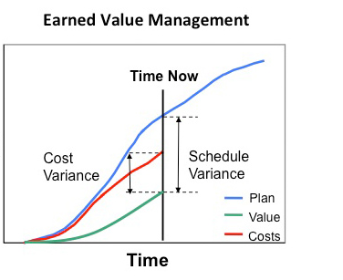
3.5 Time Logging & Project Tracking
Time log management based on individual activity
Task Category
Planning
Requirement
Analysis
Design
Implementation
Testing
Project tracking using earned value
Each developer records the actual time log
Estimate earned value (Planed Value)
Tracking project performance (Gap analysis)

Slide 25
Appendix - Glossary
Word | Defination
WMS | Warehouse Management System
Customer | Person who place order to buy the items (widgets)
Supervisor | Person who monitor and manage the warehouse system. He/she monitors order status, inventory and robot status. Also he/she managers inventory in the warehouse.
Robot | A two wheeled widget carrier designed for use in the warehouse, featuring an Arduino Uno CPU and Wi-Fi card.
Robot Status | The Status of Robot. Robot Status has monitoring information of Robot. It contains current location on the warehouse floor, the inventory on the bot, the stations visited, the next stop and the status of Robot as it moves through the warehouse.
Order | An request from the customer which specifies the widgets they want to buy and the number of each that they want to buy
Order Line | Detailed information of one item from the one order, it specifies the item type and quantity.
Item | Category of real items (Type of Item), in this context item means category of widgets
Inventory | Items in WMS which can deliver to customer
Inventory Station | A place that stock up items. Robot visit and get items and go to shipping dock.

Slide 26

Questions

